Slide 1
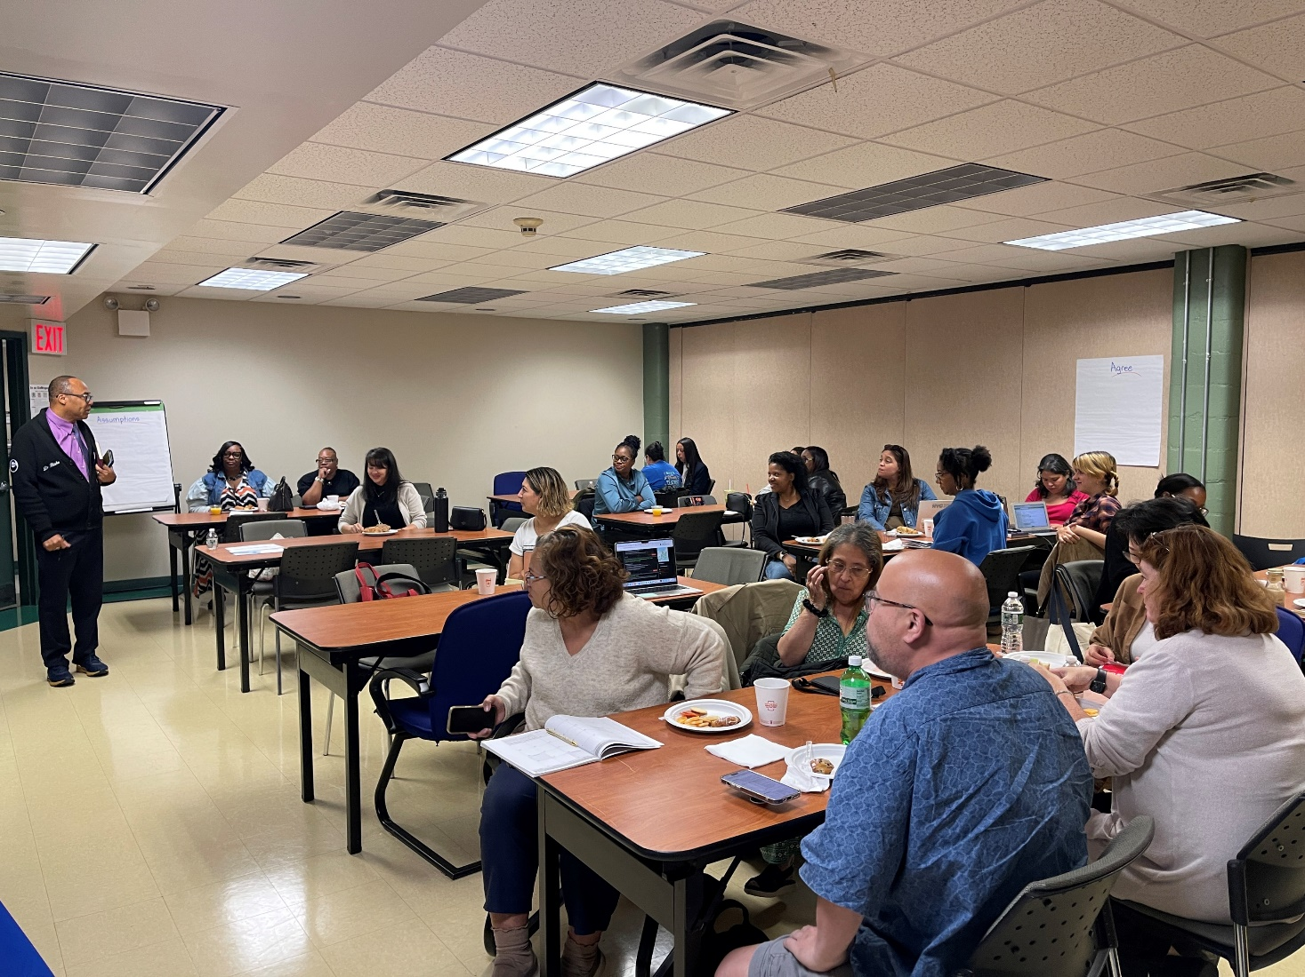
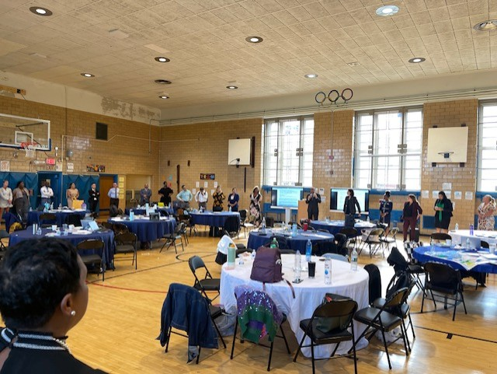

Literacy Proficiency
Math Proficiency
Chronic Absenteeism & Retention
Parent Engagement
Community
Superintendent
Dr. Eric L. Blake
Deputy Superintendent
Dr. Shonelle Hall
October 10, 2024
“With effort and support all schools can meet the needs of their students and help them achieve outstanding educational outcomes”

Slide 2
District 28 Vision, Mission & Goals
The United Nations' mission statement includes the line, "In this noble undertaking, cooperation, collaboration, unity, and solidarity must be the light we should seek and follow. We commit to strive for inestimable contribution to human progress."
Mission
In Community School District 28 we focus on equity as a lever for achievement for every single scholar. We are a district of excellence. We commit to every school maintaining high academic standards and working closely with families so that all scholars are learning at high levels. Beginning with school leaders, teachers, students and community partners, we also commit to being a district of learners ensuring that we promote critical thinking rooted in core content conceptual understanding through creative problem solving, technology innovation, social emotional learning and community advocacy.
Vision
In Community School District 28 we celebrate our differences because we understand that woven into those differences is the knowledge that they offer us unlimited possibility to learn and expand our knowledge of and commitment to all humanity. We are beautifully diverse, varied; coming from countless racial, ethnic, language, and belief backgrounds. We commit to striving for inestimable contribution to the lives of our scholars.

Slide 3
D28 Priorities:
1. Improve outcomes in mathematics by implementing a common research-based curriculum and introducing or scaling, where appropriate, Regents level courses for scholars​
2. Improve literacy skills by implementing research-based practices like the Science of Reading (SOR) and Explicit Instruction within HMH curricular resources in all K-8 schools.​
3. Work to substantially improve daily attendance and reduce chronic absenteeism.​
4. Continue to increase Parent and Family Engagement and Community Partnerships.​
​

Slide 4
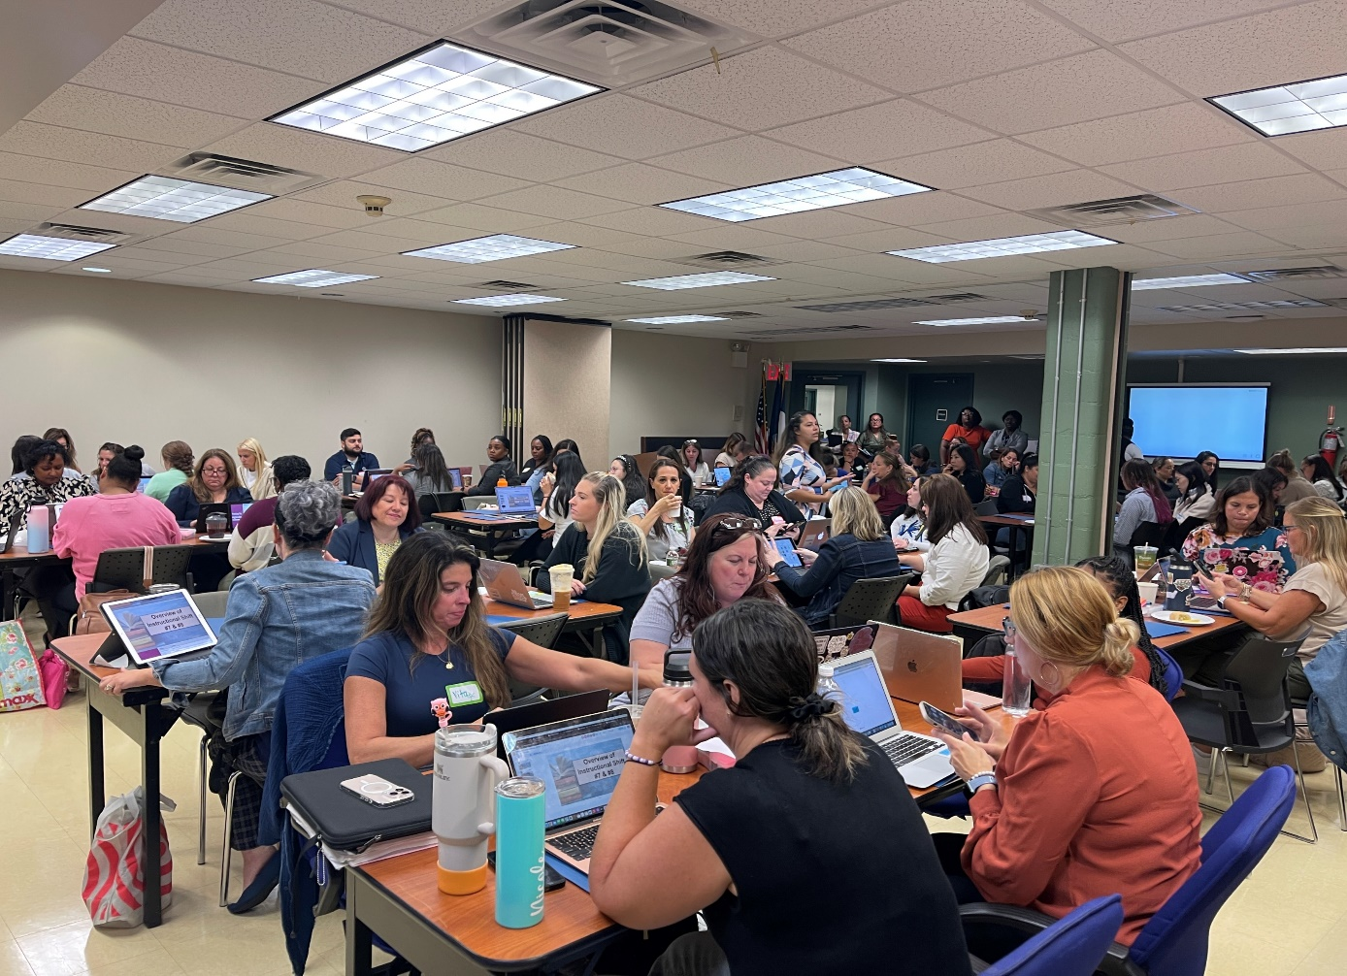
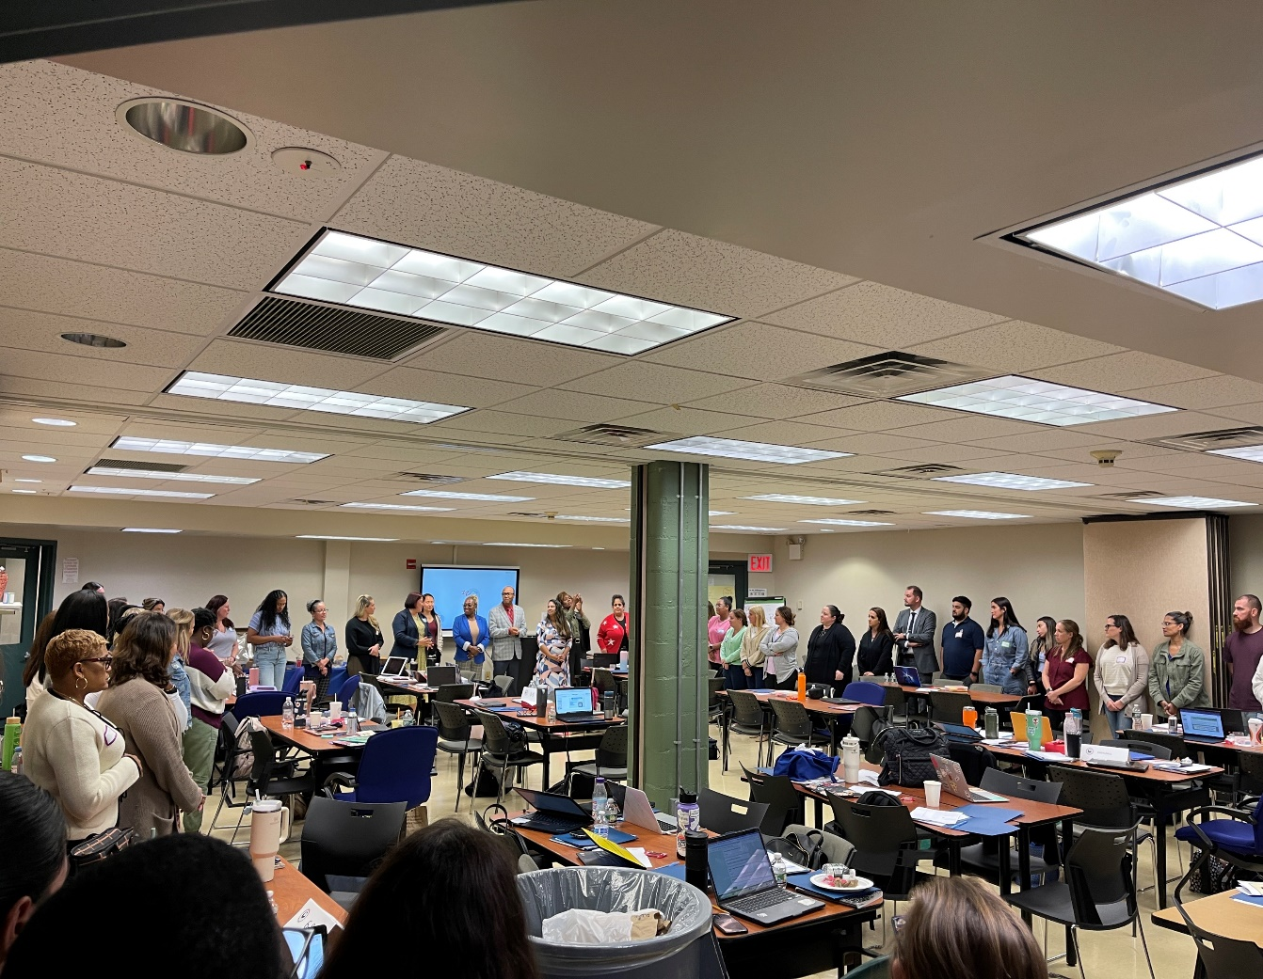
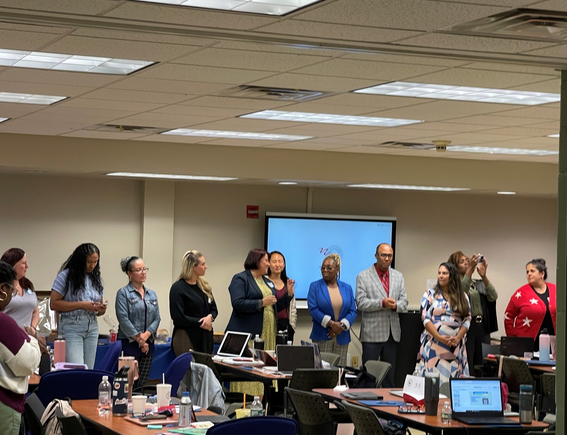
D28 PLO/Initiatives:
Professional Learning Opportunities (PLO):
    NYC Reads:
      Literacy Leaders Institute (Oct 7, 2024) – A team consisting of a Literacy Administrator, Literacy Lead, MLL Lead, and SDWEIP Lead from each of our D28 schools were all in attendance. It provided an overview of shifts 7 & 8 with an explicit instruction approach using HMH resources.

Slide 5
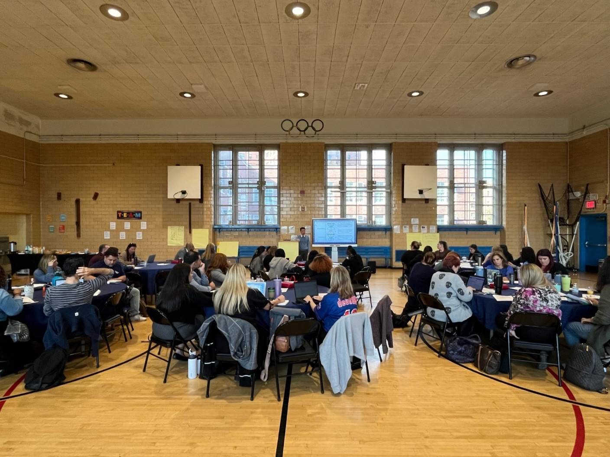
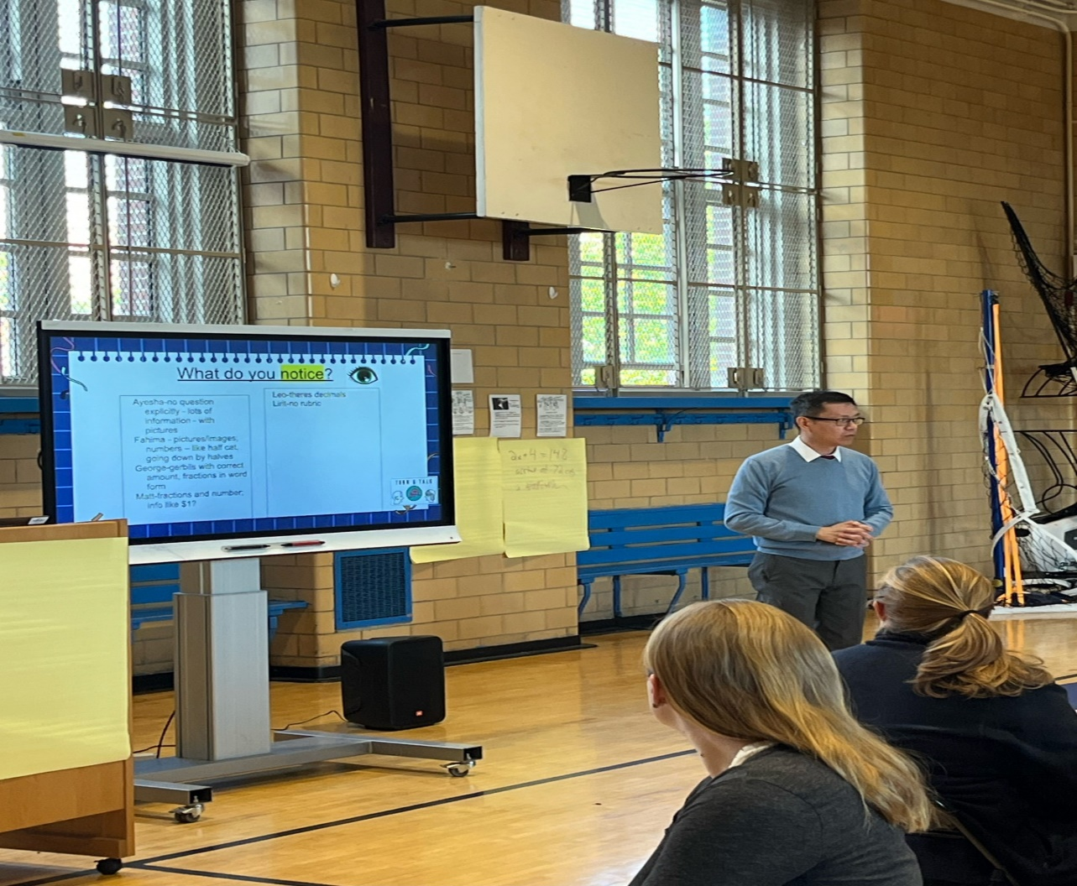
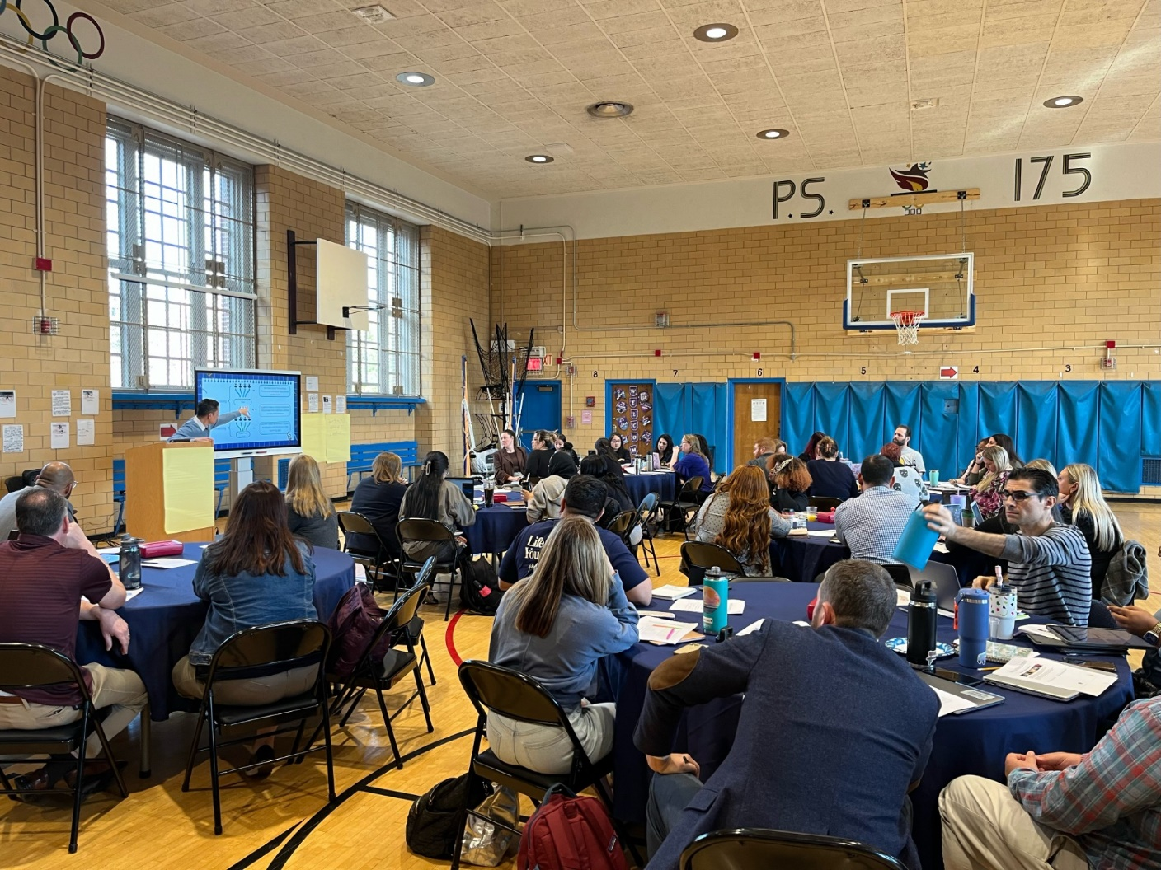
D28 PLO/Initiatives:
Professional Learning Opportunities (PLO):
    NYC Math Solves - The goal is to ensure that all New York City students develop math skills, a critical requirement for educational, career, and lifetime success, with a focused on 5 Mathematical Shifts to promote deeper discourse and understanding of math in the real world
        PLO Session 1: (Oct. 9th) - Overview of 25/26 Shifts with a focus on unpacking Shifts 1 & 2

Slide 6
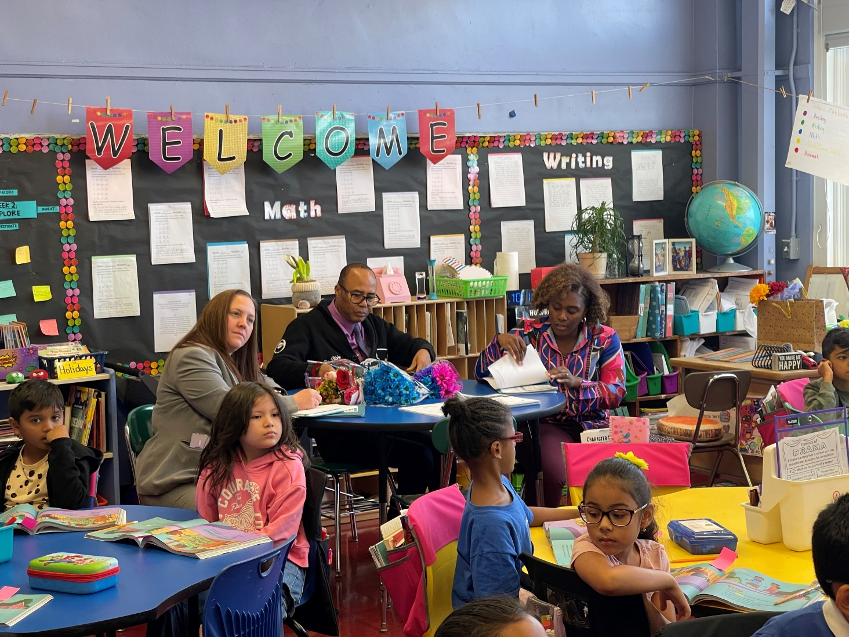
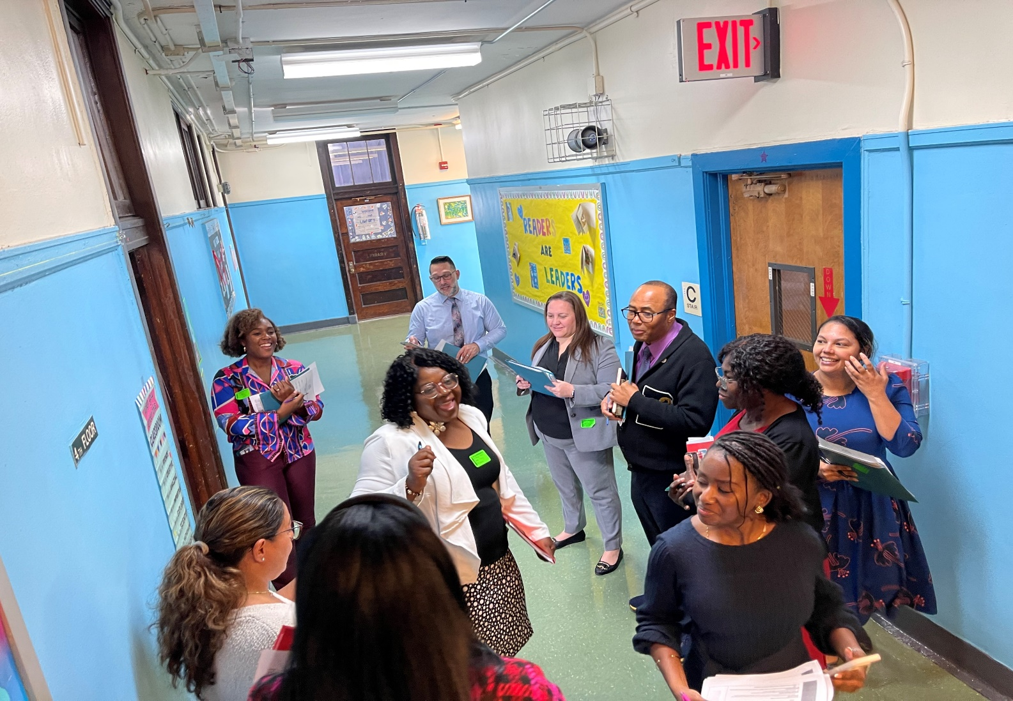
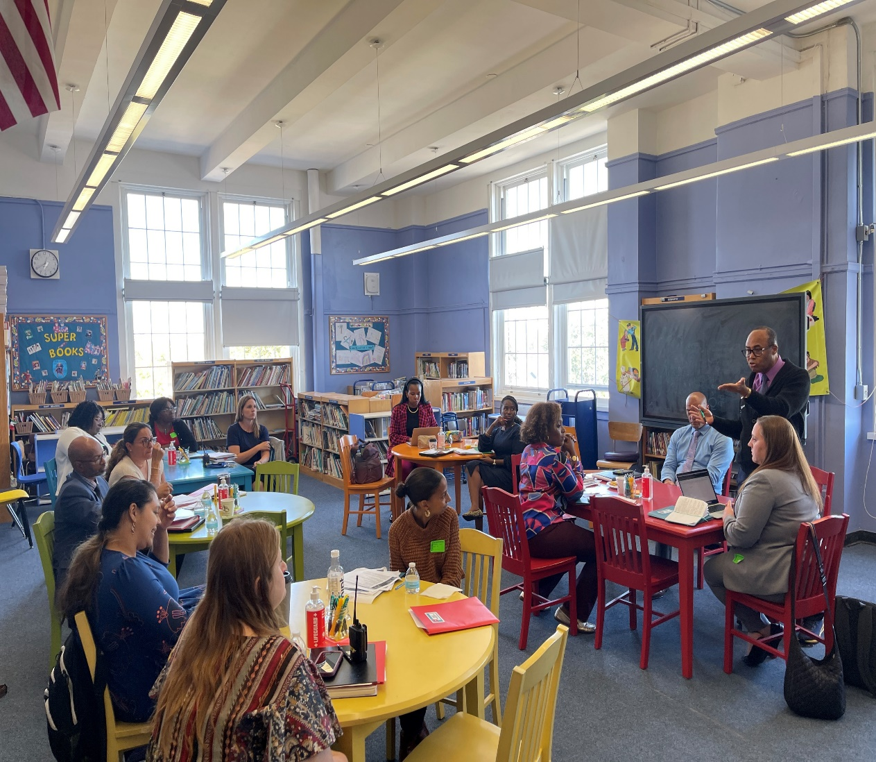
D28 PLO/Initiatives:
Professional Learning Opportunities (PLO):
    NYC Reads Walk at PS 121: On October 10, 2024, the D28 Instructional Team conducted the first in a series of ELA Implementation Walkthroughs at PS 121Q. The purpose of the walkthrough is to norm our lens and assess the trends of literacy instruction in the use of the HMH curriculum across the district. We had a fruitful day of collaboration and discussion that will inform our literacy practices and supports for schools.

Slide 7
D28 PLO/Initiatives:
Professional Learning Opportunities (PLO):
    MBK/MSK - D28 has extended our MBK/MSK programs to include 12 Elementary and 2 Middle Schools with a goal of 100% school inclusion as we build capacity.
      Focus on mentoring selected students to improve attendance, academics, & socialization
      Monthly events will be held celebrating the culture of various diasporas
      There will be 3 Culminating Events around Black Excellence. The dates and times of those events will be shared with the community in the coming weeks.
    NAACP – Continued partnership to secure STEM – related professional development
    D28 Debate League – In conjunction with the American Debate League (ADL) 6-8 schools implementing as after –school program, with district wide debate competitions

Slide 8
D28 Attendance Snapshot
DCEP - Attendance Goals
By June 2025, we will increase district-wide attendance by 2 percentage points from 90.7% to 92.7% excluding students who are long-term international travelers.
By June 2025, we will reduce overall chronic absenteeism by 10% of overall Chronically Absent Students EOY 23/24 from 35% to 31%, excluding students who are long-term international travelers.
Where are we Now: 10/2/24
YTD Overall Attendance: 92.3% vs 90.9% Citywide
Chronic Absenteeism YTD: 27.4% vs 31.0% Citywide
  *Both metrics are above the City
Professional Development:
D28 PLO Session 1 – October 2nd
  Focus on school-based practices to improve both overall attendance and chronic absenteeism
Vendors being implemented to support:
  New Visions Portal
  EveryDay Labs
  Attendance Works

Slide 9
D28 PLO/Initiatives:
    Artificial Intelligence:
    We are excited to announce that D28 is piloting an AI program in 7 of our schools. Rest assured that we are taking all aspects of this initiative into careful consideration. This includes ensuring data privacy and security, addressing ethical concerns, providing comprehensive training for our teachers, and maintaining transparency throughout the process. Our goal is to enhance personalized learning, support our educators, and prepare our students for future opportunities. We will share more about this exciting initiative at future CEC meetings.

Slide 10
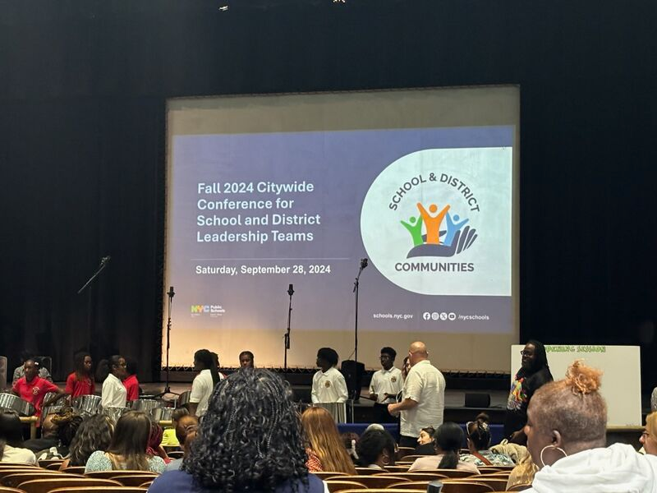
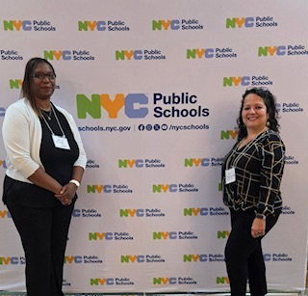
Supporting Families/Community
Elevating and Empowering SLT and DLT Voices:
    Facilitated by Shirley Aubin, Co-Chair of the Chancellor’s Parent Advisory Council and Sonia Rueda, District 28’s Family Leadership Coordinator. The workshop was focused around elevating the voices of parents serving on SLT and DLT teams. The involvement of SLT and DLT parents is essential for creating a collaborative, transparent, and supportive educational environment that benefits students, teachers, and the entire school community. Thank you, Shirley and Sonia!

Slide 11
    Celebrating Hispanic Heritage Month:
    As we honor Hispanic Heritage Month, our schools are celebrating the rich cultural tapestry and significant contributions of Hispanic and Latino communities. This month is a time to recognize the vibrant traditions, history, and achievements that have shaped our society. Let’s come together to appreciate the diversity and strength that these cultures bring to our school community, fostering an environment of inclusivity and respect.

